Slide 1
Virtual Memory Lesson 1 Introduction
David Liu
Fall 2021, Spring 2022

Slide 2
Learning Outcomes
Define virtual memory and describe its benefits.
Illustrate how pages are loaded into memory using demand paging.
Apply the FIFO, optimal, and LRU page-replacement algorithms.
Describe the working set of a process, and explain how it is related to program locality.
Describe how Linux, Windows 10, and Solaris manage virtual memory.
Design a virtual memory manager simulation in the C programming language.

Slide 3
Why Virtual Memory
Code needs to be in memory to execute, but entire program rarely used
Error code, unusual routines, large data structures
Entire program code not needed at same time

Slide 4
Execute Partially-Loaded Program
Program no longer constrained by limits of physical memory
Each program takes less memory while running -> more programs run at the same time
Increased CPU utilization and throughput with no increase in response time or turnaround time
Less I/O needed to load or swap programs into memory -> each user program runs faster

Slide 5
Virtual memory
Virtual memory – separation of user logical memory from physical memory
Only part of the program needs to be in memory for execution
Logical address space can therefore be much larger than physical address space
Allows address spaces to be shared by several processes
Allows for more efficient process creation
More programs running concurrently
Less I/O needed to load or swap processes

Slide 6
Virtual memory (Cont.)
Virtual address space – logical view of how process is stored in memory
Usually start at address 0, contiguous addresses until end of space
Meanwhile, physical memory organized in page frames
MMU must map logical to physical
Virtual memory can be implemented via:
Demand paging
Demand segmentation

Slide 7
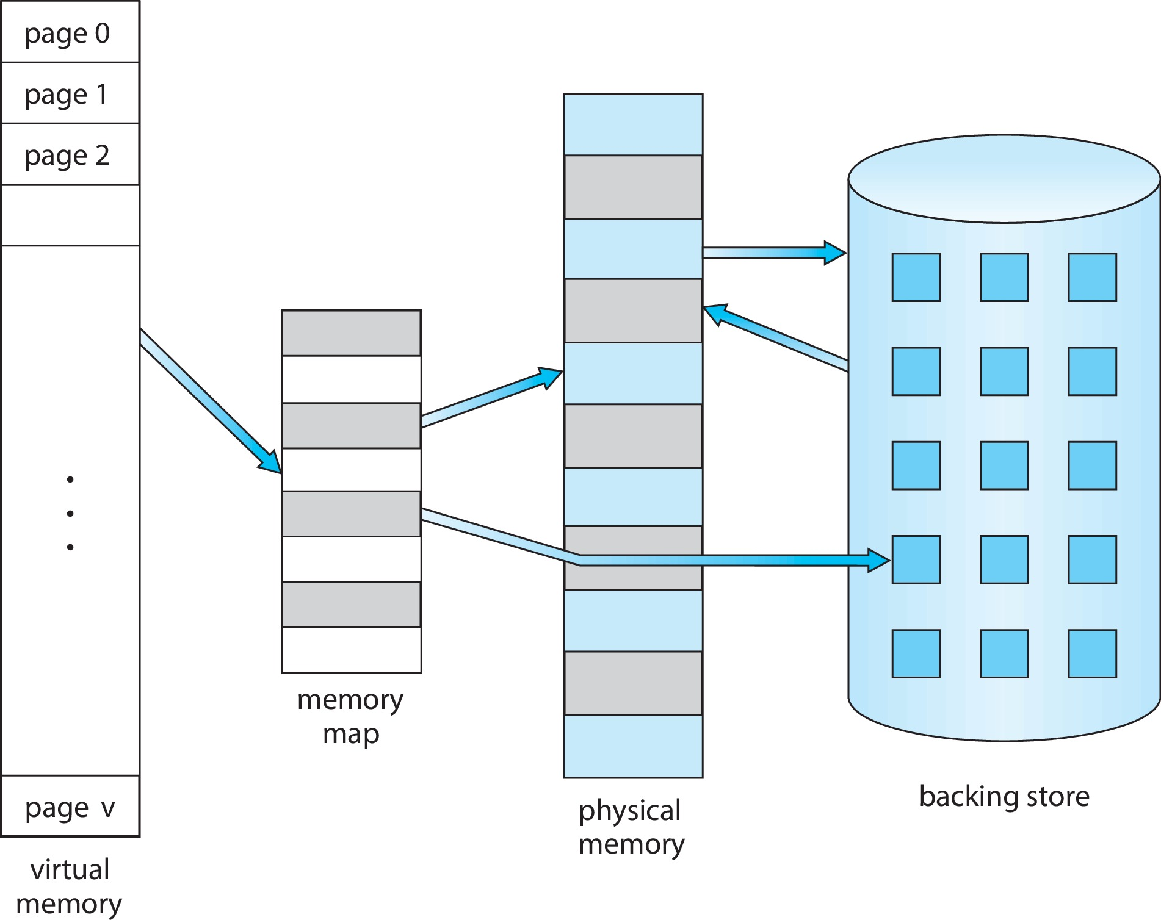
Virtual Memory Larger Than Physical Memory

Slide 8

Virtual-address Space
Usually design logical address space for stack to start at Max logical address and grow “down” while heap grows “up”
Maximizes address space use
Unused address space between the two is hole
No physical memory needed until heap or stack grows to a given new page
Enables sparse address spaces with holes left for growth, dynamically linked libraries, etc
System libraries shared via mapping into virtual address space
Shared memory by mapping pages read-write into virtual address space
Pages can be shared during fork(), speeding process creation

Slide 9
VM Benefits
Separate logical memory from physical memory
Files sharing by two or more processes
Memory Sharing by two or more processes
Shared memory by mapping pages read-write into virtual address space
System libraries shared via mapping into virtual address space
Speed process creation
Pages can be shared during fork(),

Slide 10
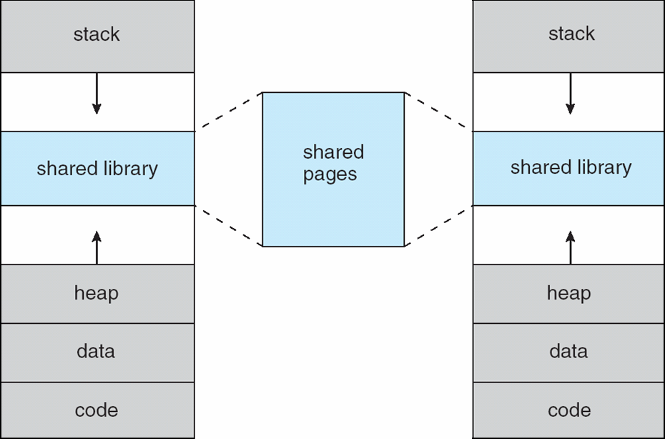
Shared Library Using Virtual Memory

Slide 11
Demand Paging vs Demand Segmentation
Consideration | Demand Paging | Demand Segmentation
Programmer aware | No | Yes
How many addr spaces | 1 | Many
VA size > PA size | Yes | Yes
Protect individual procedures separately | No | Yes
Accommodate elements with changing sizes | No | Yes
Ease user sharing | No | Yes
Why invented | let the VA size exceed the PA size | Sharing, Protection, independent addr spaces
Internal fragmentation | Yes | No, in principle
External fragmentation | No | Yes
Placement question | No | Yes
Replacement question | Yes | Yes
0
Stack
Data
0
0
Text
Three Segments

